Slide 1


CAPSTONE PROJECT KL/SELANGORRENTAL PRICE PREDICTION
SAHILA

Slide 2

KL RENTAL PRICE PREDICTION
Model Selection
Models - Logistic Regression, Decision Trees, Random Forests, and Gradient Boosting.
The evaluation - Confusion Matrix, Classification Report, F1 score, Matthews Correlation Coefficient, and ROC AUC.
Trained in 3 ways - by default, with parameter and with GridSearchCV (trial n error). (it started from a curiosity)
The model with the highest score will be selected as the best model for prediction.
Challenges:
Overfitting issue due to imbalanced dataset.
Trying to regularize it by trial and error with GridSearchCV.
Longer time taken for processing the models (due to size of the data and parameters).

Slide 3
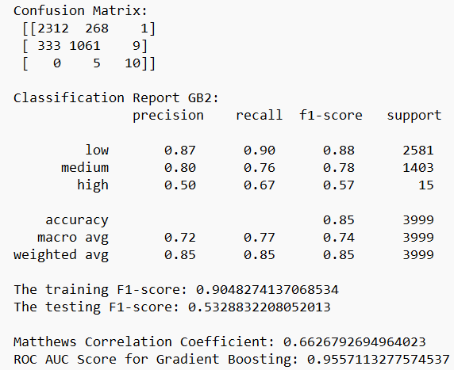
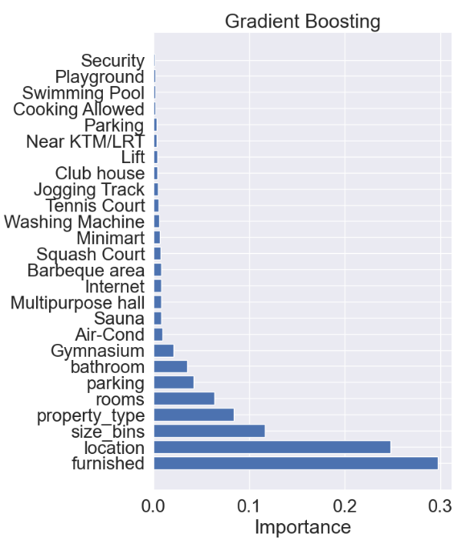
KL RENTAL PRICE PREDICTION
Results – Gradient Boosting (model 2)

Slide 4
KL RENTAL PRICE PREDICTION
Results – Gradient Boosting (model 2)
Class-Level Performance:
Consistent Performance on Majority Class: Precision and recall for the "low" class are similar between GB1 and GB2.
Improved Performance on Minority Classes:
There's a slight improvement in precision and recall for the "medium" class in GB2 compared to GB1.
Most importantly, GB2 shows significant improvement in handling the "high" class. It achieves a precision of 0.50 and recall of 0.67, suggesting it's correctly classifying some "high" class instances that previous models missed entirely.
F1-Score:
Improved Overall F1: The testing F1-score (0.53) is higher than GB1 (0.50). This reflects the improvement in generalizability and "medium" class performance.
MCC and ROC AUC:
Moderate Overall Performance: The MCC (0.66) remains similar to GB1 and tuned Random Forests. The ROC AUC score (0.95) is higher than all previously analyzed models, indicating strong overall discrimination ability.
Overall Observations:
GB2 seems to have addressed the overfitting concern to a certain extent, achieving better generalizability (higher test score) than GB1.
It significantly improves upon previous models in handling the minority "high" class, correctly classifying more instances and achieving a better F1-score.
Compared to GB1:
GB2 offers similar or slightly better performance on the majority and "medium" classes.
It demonstrates a clear advantage in handling the "high" class, which might be crucial depending on your specific needs.
Recommendation:
Given the improvement in generalizability and "high" class performance, GB2 appears to be the strongest model among those explored so far

Slide 5
KL RENTAL PRICE PREDICTION
Findings:
1. Dataset Overview and Imbalance
The original dataset contains 20k rows & 14 columns. After data cleaning and EDA, now contains 20k rows & 30 columns with various features such as property type, location, number of rooms, amenities, etc.
The target variable, rent_category, is highly imbalanced with the distribution:
Low: 12,999, Medium: 6,902, High: 90
This severe imbalance poses a significant challenge for model training and evaluation.
2. Model Performance
Multiple models were trained including Logistic Regression, Decision Tree, Random Forest, and Gradient Boosting.
Performance metrics such as F1 score, Matthews Correlation Coefficient, and ROC AUC were evaluated for each model.
Gradient Boosting with parameter is selected as the best model for now.
3. Effect of Data Imbalance
The imbalance in the dataset heavily influences the model performance, leading to potential biases toward the majority class (Low rent category).
Metrics like ROC AUC and Matthews Correlation Coefficient indicate that while some models perform well, the imbalance needs to be addressed to improve predictions for minority classes.

Slide 6
KL RENTAL PRICE PREDICTION
Risk/Assumption/Limitation:
Model Bias: Machine learning models can be biased towards the majority class during training. In this case, a model trained on this data might perform well for "low" rentals but perform poorly for "medium" and "high" rentals due to a lack of sufficient data for these categories. This can lead to inaccurate predictions and unreliable risk assessments for these rental categories.
Class Imbalance: The extreme imbalance between "low" and other categories suggests potential class imbalance issues. Techniques like oversampling, undersampling, or cost-sensitive learning might be necessary to address this imbalance and improve model performance for minority classes in the future.
Rental Market Representation: The data is assumed to be representative of the actual rental market distribution. If the data comes from a specific source or region with a unique rental landscape, it might not generalize well to other markets.
Limited Generalizability: The model might not perform well on unseen data with a different rental category distribution. For example, if the model is deployed in a market with a higher proportion of "medium" or "high" rentals, its predictions might be unreliable.
Data Quality: Data quality can affect the model's performance. Errors, missing info, or inconsistencies in the data can lead to unreliable model predictions.
Data Understanding: Building a good model requires a deep understanding of the data and its industry. Failing to grasp the data and its context can lead to flawed models. Data analysis is essential for translating raw data into insights that guide effective model building.

Slide 7

THANK YOU

